Slide 1
Understanding SEC Codes: From ARC to XCK
Date XX, 20XX

Slide 2

Presented by:
Ellen Jacques, AAP Director, TCH Payments Association 212-613-9892 ellen.jacques@theclearinghouse.org

Slide 3

Agenda
ACH – a brief overview
Standard entry class codes
Definitions
Benefits of usage
Examples
Legal framework

Slide 4

Who are the ACH Participants?
Receiver
Originator
ODFI
ACH Operator
Federal Reserve Bank (FedACH)
Electronic Payments Network (EPN)
RDFI
Optional Parties:
Third Party Service Provider (TPSP)
Third Party Sender
Correspondent Bank

Slide 5
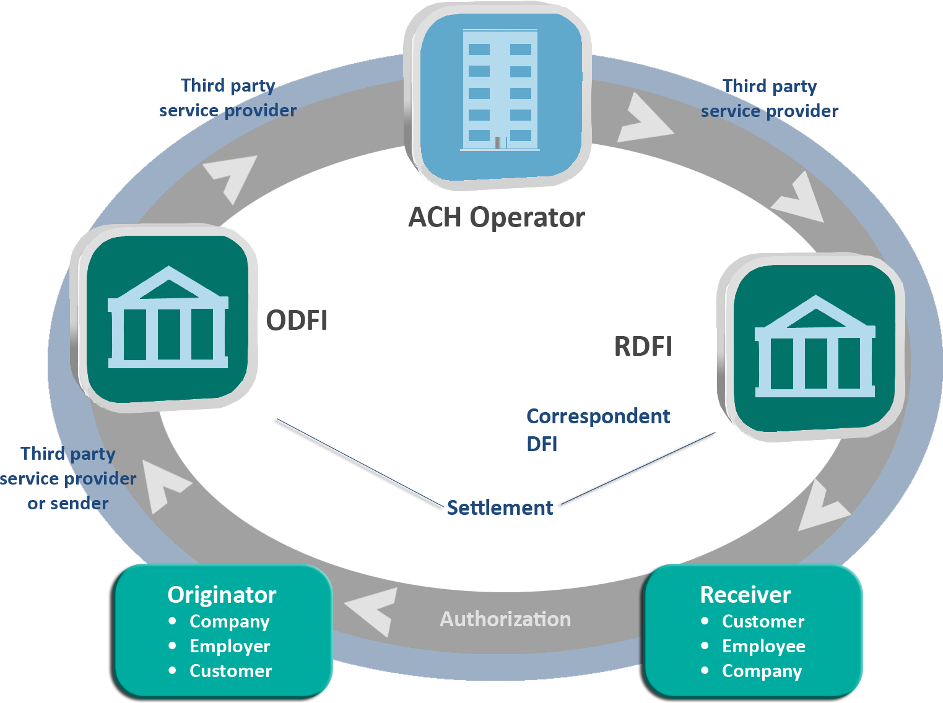
ACH Payment Flow — with Optional Participants

Slide 6
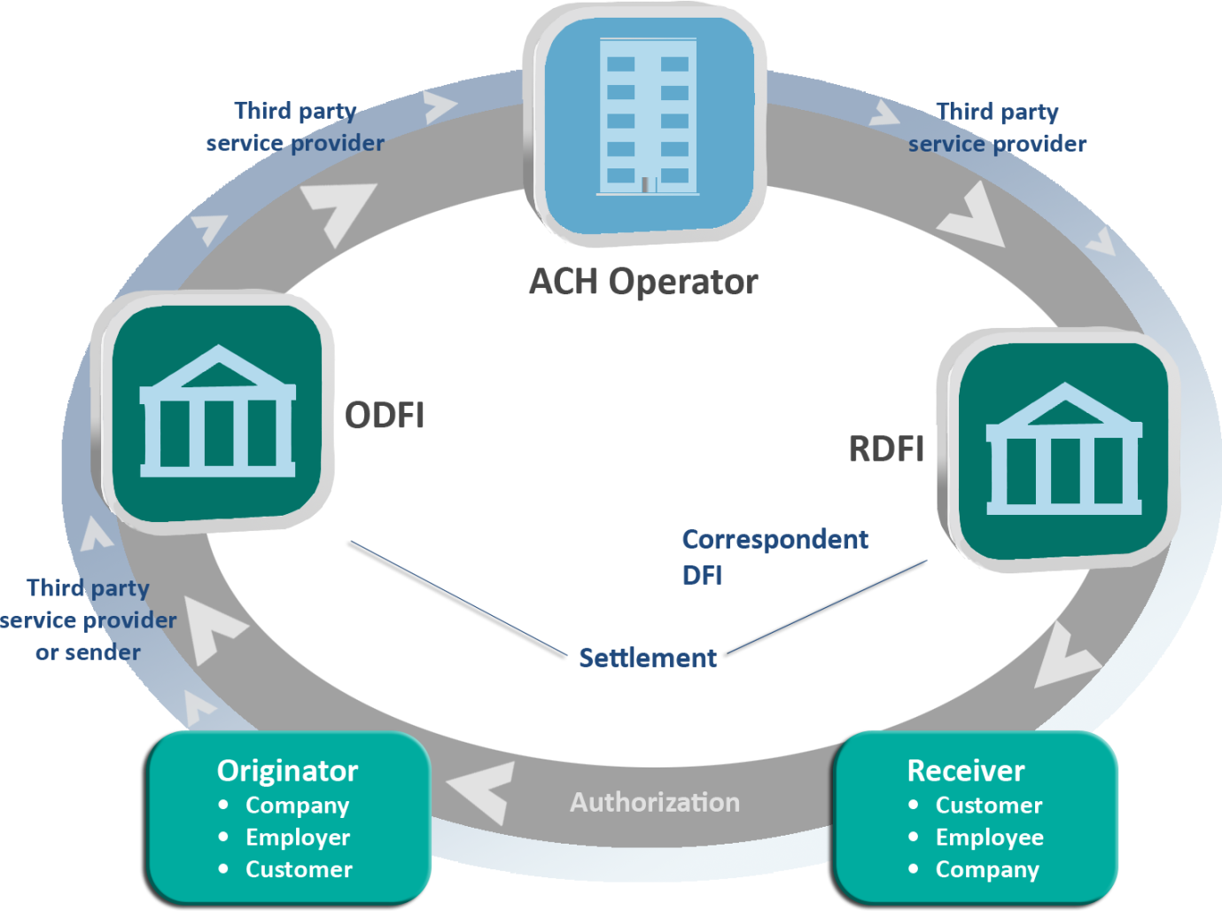
ACH Payment Flow — with Optional Participants

Slide 7

Rules and Regulations Governing ACH Transactions
2012 NACHA Operating Rules
www.achrulesonline.org
Regulation CC, D and E
http://www.federalreserve.gov/ bankinforeg/reglisting.htm
31 CFR Part 210
www.fms.treas.gov/greenbook
Office of Foreign Assets Control
www.treas.gov/offices/enforcement/ofac
ODFI/Originator Agreements
(NACHA Operating Guidelines Appendix C OG255-256
UCC4A
www.law.cornell.edu/ucc/4A
State laws

Slide 8
Standard Entry Class Code
A Standard Entry Class (SEC) Code is the three character code that identifies the payment type and formatting requirements
The SEC Code permits various kinds of ACH Entries to be distinguished
The SEC Code is found within the ACH Company/Batch Header record of the ACH File

Slide 9
All Standard Entry Class Codes (SEC)
Three character code that identifies the payment type and formatting requirements
Consumer Codes
CIE – Customer Initiated Entry
DNE – Death Notification Entry
ENR – Automated Enrollment
PPD – Preauthorized Pay/Deposit
RCK – Represented Check
TEL – Telephone Initiated Entry
WEB – Internet Initiated/Mobile Entry
Other Codes
ADV – Statement of Activity – ACH format
COR – Correction (NOC)
Consumer Codes
Corporate Codes
ACK, ATX - Acknowledgements
CCD – Corporate Credit or Debit
CTX – Corporate Trade Exchange
Consumer/Corporate Codes
ARC – Accounts Receivable Entry
POP – Point of Purchase
BOC – Back Office Conversion
TRC, TRX - Truncated Checks
XCK – Destroyed Check Entry
IAT – International ACH Transactions
Debit Card/POS Entries
MTE – Machine Transfer Entry
POS, SHR – Point of Sale, Shared

Slide 10
Rules and Regulations Governing Consumer ACH Transactions
2012 NACHA Operating Rules
Regulation CC
Regulation D
Regulation E

Slide 11
Consumer Codes
CIE – Customer Initiated Entry
DNE – Death Notification Entry
ENR – Automated Enrollment
PPD – Preauthorized Pay/Deposit
RCK – Represented Check Entry
TEL – Telephone Initiated Entry
WEB – Internet Initiated Entry

Slide 12
CIE ― Customer Initiated Entry
Used to identify credit Entries initiated by an Originator (consumer), usually to pay an obligation of such individual
May be accompanied by one Addenda Record that relays information using payment-related ANSI ASC X12 data segments
FI or service provider provides online bill pay platform, consumer enters the information for the Receiver and a CIE credit Entry is created and sent through the ACH Network
Consumer is the Originator of the debit, company is the Receiver of the credit
CIE is now used for Secure Vault Payments and EBIDS payments as well

Slide 13
DNE ― Death Notification Entry
A non-monetary entry from a Federal Government agency
Notifies the Financial Institution that the recipient of a government benefit has passed away
Governed by 31 CFR Part 210
Allows for the reclamation process to begin

Slide 14
DNE ― Benefits
Allows the RDFI to take steps to reduce exposure to loss resulting from the withdrawal of funds after the beneficiary’s death by a joint account holder
The RDFI must flag the account and return any future government payments
Reduces and allows for the reallocation of the RDFI’s resources that are used to process Government reclamation actions
Possible reduction of the number of reclamations produced by the U.S. Department of Treasury’s Financial Management Service, saving the RDFI processing costs
RDFIs can limit their losses due to reclamations

Slide 15

ENR ― Automated Enrollment
The ENR process allows DFIs to transmit information to Federal Government agencies, on behalf of their account holders, that serves as an enrollment for either ACH credit or debit activity
It is a Non-Monetary Entry that triggers the origination of ACH credit or debit transactions to the account holder at the DFI
Governed by 31 CFR Part 210
Additional use began in 2011: Allows FIs to originate enrollments for Electronic Billing Information Delivery Service (EBIDS) for automated receipt of billing statement to consumer through online banking

Slide 16
PPD ― Prearranged Payment and Deposit Entries
Most common SEC: recurring consumer credits or debits
Considered a “native payment”
First type of ACH payment
Lower risk
Preauthorized in writing, signed or similarly authenticated
Copy of authorization is provided to consumer
Originator must maintain authorization for 2 years beyond revocation
Must provide a copy of authorization to RDFI within 10 banking days of written request
Originator must inform Receiver of changes
In Settlement Date – 7 calendar days in advance
Of amount – 10 calendar days in advance

Slide 17
RCK Entries ― Re-presented Check Entries
Used to electronically re-present paper Checks dishonored for NSF/Uncollected funds
Governed by Reg CC, UCC law and the NACHA Operating Rules
Originator must notify Check writer of policy before accepting Check
Notification
RCK Entry must be sent for face amount of Check only
Fees must be sent separately using the appropriate SEC code (such as PPD)
3 presentments only
1 by Check and 2 by ACH (or)
2 by Check and 1 by ACH
NSF
20___

Slide 18
RCK Entries ― Re-presented Check Entries
RCK-eligible items include:
Amount less than $2,500
Contains pre-printed Check Serial Number
Indicates on document face: “Not Sufficient Funds,” “NSF” or “Uncollected Funds”
Drawn on Consumer account
Not dated more than 180 days previous
Additional warranties by ODFI for RCK Entries include:
Good title
Authentic and Authorized signatures
Item has not been altered
No claims to item
No knowledge of insolvency
RCK Entry accurately reflects the original item
Encoding is correct
Restrictive endorsement is void or ineffective
ODFI will provide to RDFI a copy of the front and back of the item within 10 Banking Days of RDFI’s written request

Slide 19
TEL ― Telephone-initiated Entries
Permits Originator of a Single-Entry or recurring consumer debit to obtain the consumer’s authorization (and banking information) orally via the telephone
Governed by Regulation E and the NACHA Operating Rules
May be transmitted when there is:
An existing relationship between Originator and consumer, or
No relationship between Originator and consumer, but consumer initiates the call
Originator must either:
Tape record the consumer’s oral authorization, or
Provide, in advance of the Settlement Date, written notice to consumer confirming oral authorization (Written notice must be provided for recurring TEL authorizations as per Reg. E)
Requirements include minimum information that must be included by Originator as part of the authorization
Payment Type Code field indicates whether Entry is Single or recurring

Slide 20
TEL ― Telephone-initiated Entries
Risk concerns
Potential for misuse through the origination of an unauthorized ACH Debit transactions
Some Entries may be originated as a result of deceptive and fraudulent telemarketing practices
Correlation has been established between high return rates and Originators violating the NACHA Operating Rules or are engaged in potentially fraudulent or deceptive trade practices
Authorization Revoked (R07) for Single-Entry TEL – is now allowed if Entry was scheduled “in advance”

Slide 21
Web ― Internet-initiated/Mobile Entries
Identifies consumer debit Entry initiated pursuant to authorization obtained from Receiver via the Internet or Wireless Network
Governed by Regulation E and the NACHA Operating Rules
Debit can be recurring or a one-time transfer (Single Entry) from a consumer account
‘R’ for recurring
‘S’ for single
Can be found in the Payment Type Code field
Authorization Revoked (R07) for Single-Entry WEB – is now allowed if Entry was scheduled “in advance”

Slide 22
Web ― Internet-initiated/Mobile Entries
Web transactions are associated with high risk because of the anonymous nature of the Internet
Originators must employ stringent risk management requirements including:
Authentication
Fraudulent Transaction Detection Systems
Verification of Routing Numbers
Security of Internet sessions
Annual Security Audits (Appendix Eight)
ODFIs should address the risk issues related to web transactions within the agreements they have with their Originators

Slide 23
It’s Quiz Time!
What SEC Code is used for an automated enrollment?
What type of transaction takes place in an anonymous environment?
What SEC Code is used for a direct payment?
Are recurring TEL transactions allowed?
What governs government payments?

Slide 24
Regulations Governing Consumer and Corporate Transactions
2012 NACHA Operating Rules
Regulation E
Regulation E provides a 60-day return time frame for unauthorized transactions on both consumers and corporates that are participating in ARC, BOC and POP Entries
OFAC screening for International Transactions (IAT)

Slide 25
Consumer and Corporate SEC Codes
ARC – Accounts Receivable Conversion
POP – Point of Purchase
BOC – Back Office Conversion
TRC, TRX – Truncated Checks
XCK – Destroyed Check Entry
IAT – International ACH Transaction

Slide 26
ARC ― Accounts Receivable Entry
Originators can convert consumer or corporate Checks (that do not contain an auxiliary on-us field) received 1.) via U.S. mail, 2.) at a drop box location, or 3.) in person for payment of a bill at a manned location and then converted to be collected via the ACH
Must be $25,000 or less
Ineligible items are HELOC, credit card checks, and others
Originator must provide notice to the Receiver in advance (sample wording is provided in Rules)

Slide 27
ARC ― Accounts Receivable Entry
ODFI warranties include:
Entry information is accurate
Eligible Source Document may not be presented for payment
Copy of front of source document kept for two years by Originator & will provide copy to ODFI upon request
Secure storage of payment information
Originator has employed commercially reasonable methods to store all source documents until destruction and all banking information related to ARC Entries

Slide 28
ARC ― Accounts Receivable Entry
Risks for ODFI
Originators are responsible for verifying the Receiver's account information but not account owner
Secure storage of copy of item
Risks for RDFI
Unauthorized transactions posting to consumer’s account
A depository institution could be presented with an invalid ACH transaction, a “duplicate” in the form of the original Check, an image presentment, or an IRD, depending on how the original item was processed and who came into possession of what instrument or information

Slide 29
BOC ― Back Office Conversion Entry
Originators can decide whether to convert consumer or corporate Checks (that do not contain an auxiliary on-us field) received in person for purchases or payments and initiate a one-time ACH debit (or) process as a Check
If converted to an ACH debit, the Check:
Must be $25,000 or less
Ineligible items are HELOC, credit card Checks, and others
Based on notice equals authorization and use of the Check as a source document
The Check will be not be returned to the Receiver
A copy of the authorization notice must be given to the Receiver at the point of purchase/manned bill payment location

Slide 30
BOC ― Back Office Conversion Entry
Minimizing Risks associated with BOC
Originator verifies the identity of the Receiver prior to accepting Check
Originators must securely store all documents associated with the BOC Entry
Originator provides Customer Service Telephone Number on the notice, and warrants that all Entry information captured is accurate
ODFIs must keep specific information on the Originator
Company name
Address
Telephone number
Contact person
Taxpayer ID number
Description of the nature of the business
ODFI must provide the specific Originator information within two Banking Days of receipt of RDFI’s written request

Slide 31
POP ― Point-of-Purchase Entry
Originators can convert consumer or corporate Checks (that do not contain an auxiliary on-us field) received in person for purchases or a manned bill payment location and initiate a one-time ACH debit
Must be $25,000 or less
Ineligible items are HELOC, credit card Checks, and others
Based on written authorization and use of the Check as a source document
The Check will be voided and returned to the Receiver at the point of purchase
A copy of the written authorization and a receipt for purchases must be provided to the Receiver as well

Slide 32
POP ― Point-of-Purchase Entry
To minimize Risk, ODFIs warrant:
The Originator has provided each Receiver with receipt containing specific information, for each POP transaction
The source document used for POP Entry must be voided and returned to the Receiver at point of purchase
The source document used for POP Entry has not been used in any prior POP Entry by the Receiver
The POP receipt must contain:
Originator name and Merchant number
Company or TPSP telephone number
Date of Transaction
Transaction Amount
Check Serial Number of Eligible Source Document
Terminal City and Terminal State (as defined in Reg E)
Source: BCG Report “The Future of Mobile Payments” 2012

Slide 33
TRC ― Truncated Entry
Identifies a single truncated Check being safekept by the Originator as defined by a Check truncation program and processed as an ACH debit Entry

Slide 34
TRX ― Truncated Entries Exchange
Identifies truncated Checks being safekept by the Originator as defined by a Check truncation program
Allows financial institutions to use a single ACH Entry to carry information from multiple Checks
Must be accompanied by Addenda Records that relay information formatted in National Association for Check Safekeeping syntax
TRX allows one Entry for multiple Checks, using up to 9,999 Addenda Records – one for each truncated Check
34

Slide 35
XCK ― Destroyed Check Entry
Used to identify debit Entry initiated by an ODFI when Check(s) contained in a cash letter has been lost, destroyed or otherwise unavailable while in transit for presentment to a paying bank
September 16, 2011 – Expanded usage of XCK
Now also allows use of XCK to collect Checks that are damaged and cannot be imaged, or for which the image cannot be processed, such as:
A Check missing part of the MICR line but can be repaired to create an ACH debit
A Check that is unreadable, obscured, or mutilated and prevents automated check or image processing, but has an intact MICR line
RDFI may return XCK Entries (at its sole discretion) with Return Code R33 (60 calendar day return time frame)
ODFI must provide a copy of the item to which the XCK relates to the RDFI within thirty days of receiving RDFI’s written request – if received within six years from the date the XCK was initiated

Slide 36

IAT ― International ACH Transaction
Implemented: September 18, 2009
Identifies a debit or credit Entry that is part of a payment transaction involving a financial agency’s office that is not located in the territorial jurisdiction of the US
IAT Entries are structured to comply with U.S. Law and:
Carry the additional data requirements included in the Bank Secrecy Act’s “Travel Rule” as requested by OFAC
7 Distinct Mandatory Addenda Records – each supplying additional identification for the different parties to the transaction
Also allows 2 Optional Remittance Addenda Records and up to 5 Optional Addenda Records to identify Foreign Correspondent FIs*
May contain OFAC Screening Indicators to aid FIs in effective interdiction of unlawful transactions (“1” suspect, “0” non suspect)

Slide 37

IAT ― International ACH Transaction
ACH Operators acting as a Gateway may process Outbound debit and credit Entries but must limit Inbound IAT Entries to credits only; whereas DFIs acting as a Gateway may process Inbound and Outbound debits and credits
Gateways that identify suspect inbound debit Entries must not forward those Entries to the RDFI, but contact OFAC first
RDFIs receiving Inbound IATs must additionally screen all IAT Entries in their entirety (Receiver, Originator and Addenda information)
ODFIs – Review all parties to an Outbound IAT transaction for OFAC compliance prior to origination to ACH Operator
Certain Rules Exceptions exist for Inbound and Outbound IAT Entries to the extent that the laws and payment system rules of the foreign country apply

Slide 38
Corporate Codes
ACK, ATX – Acknowledgements
CCD – Corporate Credit or Debit
CTX – Corporate Trade Exchange

Slide 39
Rules and Regulations Governing Corporate Transactions
NACHA Operating Rules
UCC4A (Default is New York state law)

Slide 40
ACK ― Acknowledgment Entry
Identifies an acknowledgment of receipt by the RDFI of a corporate credit payment and (optional) related information originated using the CCD format
May be accompanied by one Addenda Record which relays information about the financial EDI credit payment
Optional Entry and done by mutual agreement between the RDFI and the ODFI

Slide 41
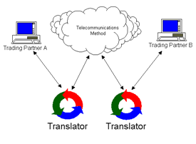
ATX ― Financial EDI Acknowledgment
Identifies an acknowledgment of receipt by the RDFI of a corporate credit payment and (optional) related information originated using the CTX format
May be accompanied by 1 one Addenda Record
Optional Entry and done by mutual agreement between the RDFI and the ODFI

Slide 42
CCD ― Corporate Credit or Debit
Identifies debit and credit Entries initiated by an Originator to create a transfer of funds to or from the account of that organization or another organization
May be accompanied by one Addenda Record (sometimes referred to as “CCD+”)
Most common B to B payment type through ACH
Authorization/agreement rules indicate that the two parties must agree to follow NACHA Operating Rules
CCD+ has been selected by the Healthcare Industry for healthcare related EFTs (Electronic Funds Transfer) including the Addenda Record containing Reassociation data to match to Electronic Remittance Advices (ERA)

Slide 43
CTX ― Corporate Trade Exchange
Is also a “B2B” payment where both Originator and Receiver are companies
Identifies credit or debit Entries originated by an Originator to pay or collect an obligation of the Originator and destined for the account of another organization
Authorization/agreement rules indicate that the two parties must agree to follow NACHA Operating Rules
A CTX payment can have up to 9,999 optional Addenda Records—containing extensive remittance details (EDI formats)—is commonly used by the U.S. government to pay vendor companies for good or services provided
Use of CTX by companies is on the rise

Slide 44
CCD/CTX Risk
There is risk associated with unauthorized transactions and CCD/CTX Entries
The return time frame for these corporate unauthorized transactions is 2 days from Settlement Date (R29)
RDFIs need permission from an ODFI to return these Entries after the 2 day return time has passed (R31)
Corporate customers of RDFIs need to closely monitor their accounts in order to promptly report any unauthorized transactions they become aware of
Agreements must be in place between Originators and ODFIs before any transactions occur

Slide 45
Debit Card/POS Entries
MTE – Machine Transfer Entry
POS, SHR – Point of Sale Entry, Shared Entry

Slide 46
MTE ― Machine Transfer Entry
Identifies a credit or debit Entry that was initiated at an electronic terminal to effect a funds transfer to or from a deposit account of an Originator maintained with a RDFI
Must be accompanied by an Addenda Record to provide the terminal location, city, state and other required information

Slide 47
POS ― Point of Sale
POS Entry identifies a debit initiated at an electronic terminal as defined in Regulation E
Usually initiated by the use of a merchant-issued plastic card
Originated in a non-shared system in which no agreement other than the NACHA Operating Rules exist between the ODFI and the RDFI
Must be accompanied by an Addenda Record to provide the terminal location, city, state and other required information

Slide 48
SHR ― Shared Network Transaction
Identifies debit Entries initiated at an electronic terminal as defined by Regulation E
Usually initiated by the use of a bank-issued plastic card
Like a POS Entry, except that it originates in a shared system where an agreement, in addition to the NACHA Operating Rules exists between the ODFI and RDFI
Must be accompanied by an Addenda Record to provide the terminal location, city, state and other required information

Slide 49
Other Codes
ADV – Statement of Activity – ACH format
To identify automated accounting advices of ACH Accounting information in machine-readable format and to facilitate the automation of accounting information for participating DFIs
Optional service provided by ACH Operators only
Must be requested
A Non-Monetary Entry

Slide 50
Other Codes
COR – Correction (NOC, Notification of Change)
Identifies an automated Notification of Change or a refused Notification of Change
A COR Entry must be accompanied by an Addenda Record to specify Change Code and changed information
A Non-monetary Entry
RDFI deadline: two Banking Days after Settlement Date to send an NOC, except in cases of merger/acquisition

Slide 51
COR ― Notification of Change Entry
It is the responsibility of the ODFI to ensure the Originator makes the necessary changes before initiating the next live dollar transaction
In the event there is an error with the NOC received from the RDFI, it is the responsibility of the ODFI to return it back to the RDFI within 15 days (A Refused NOC)
The RDFI may make the changes listed in the Refused NOC and send a corrected NOC to the ODFI within 5 Banking Days
NOC, Refused NOC and Corrected NOC all use COR Code

Slide 52
It’s Quiz Time—Again!
Which Standard Entry Class Code would be used when a check that is mailed in as a bill payment is converted to an ACH Transaction?
Which Standard Entry Class Code would be used for a credit transaction to a consumer’s account that came via ACH from a company in Europe?
What is the SEC Code for a Correcting Entry?
Explain the difference between a CCD and a CTX
When would you see an ACK SEC Code Entry?

Slide 53
Additional Resources
epaynetwork.com
nacha.org
achrulesonline.org
paymentsuniversity.com
electronicpayments.org

Slide 54
Questions?
Thank you for your participation!

Slide 55


